Slide 1
Rapport La chouette agence
SEO
Performance
Accessibilité

Slide 2
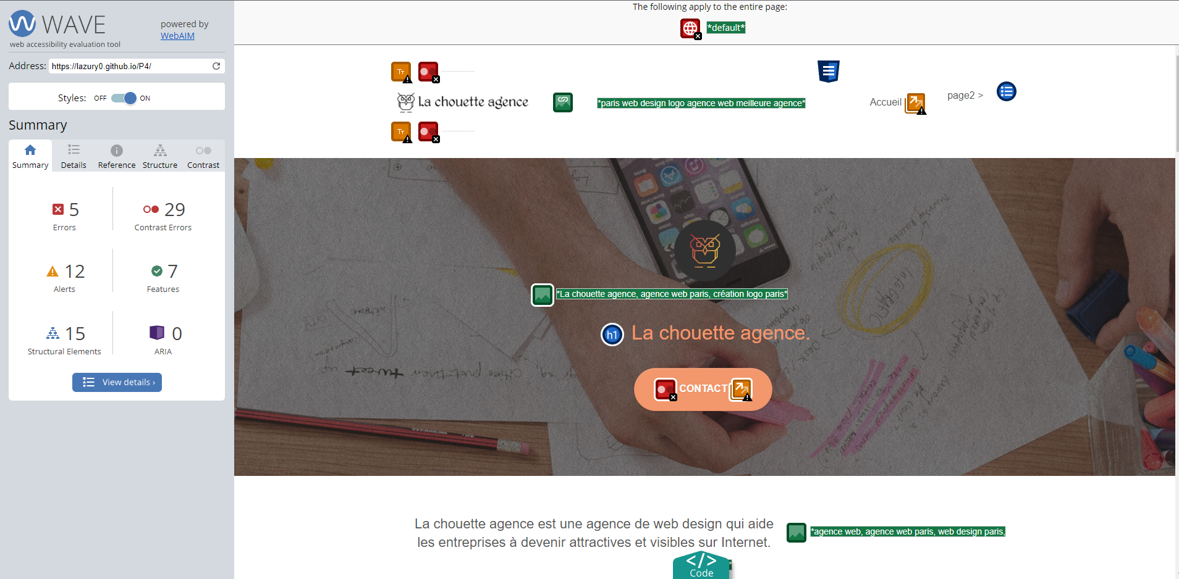
WebAIM Wave

Slide 3
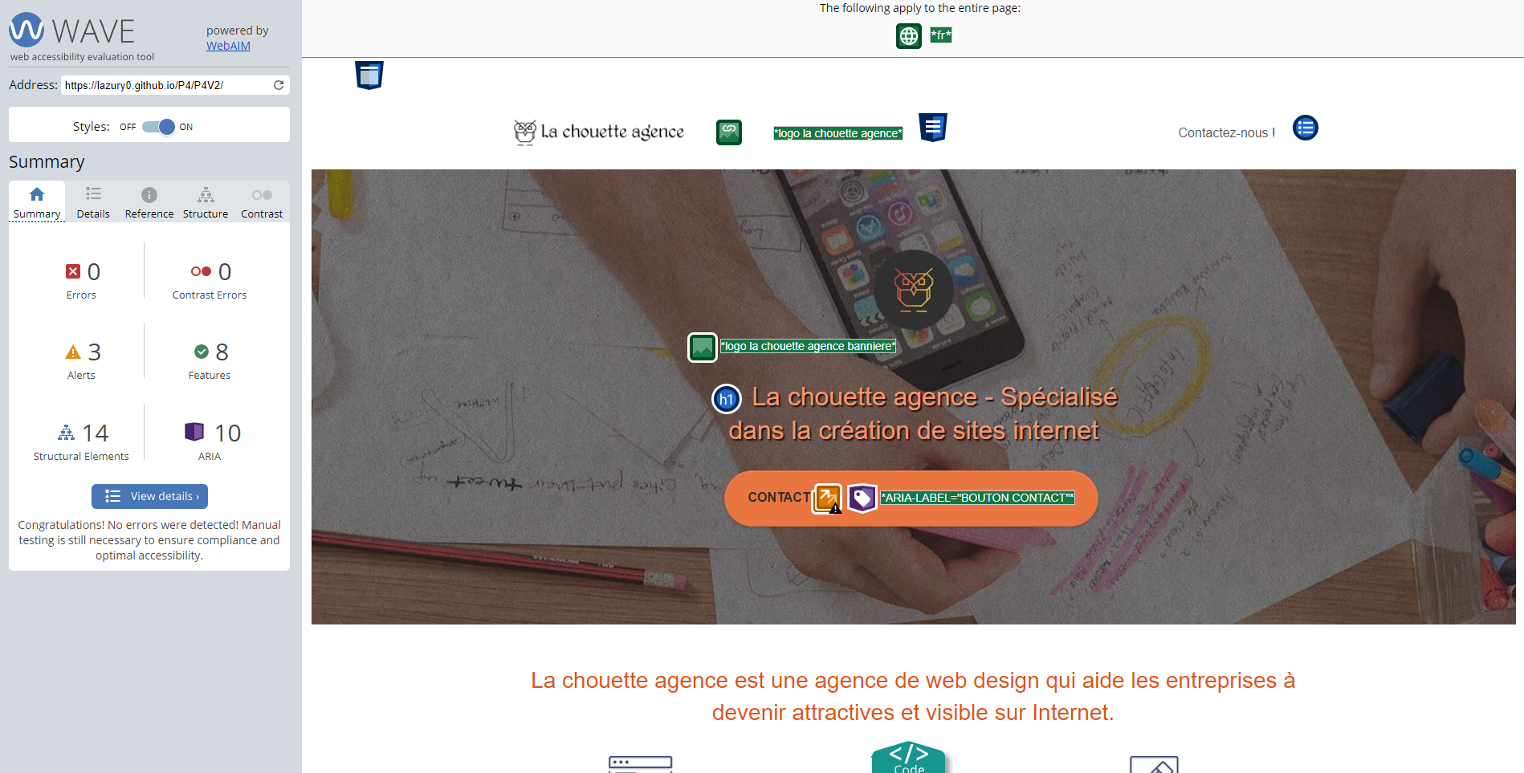
WebAIM Wave

Slide 4
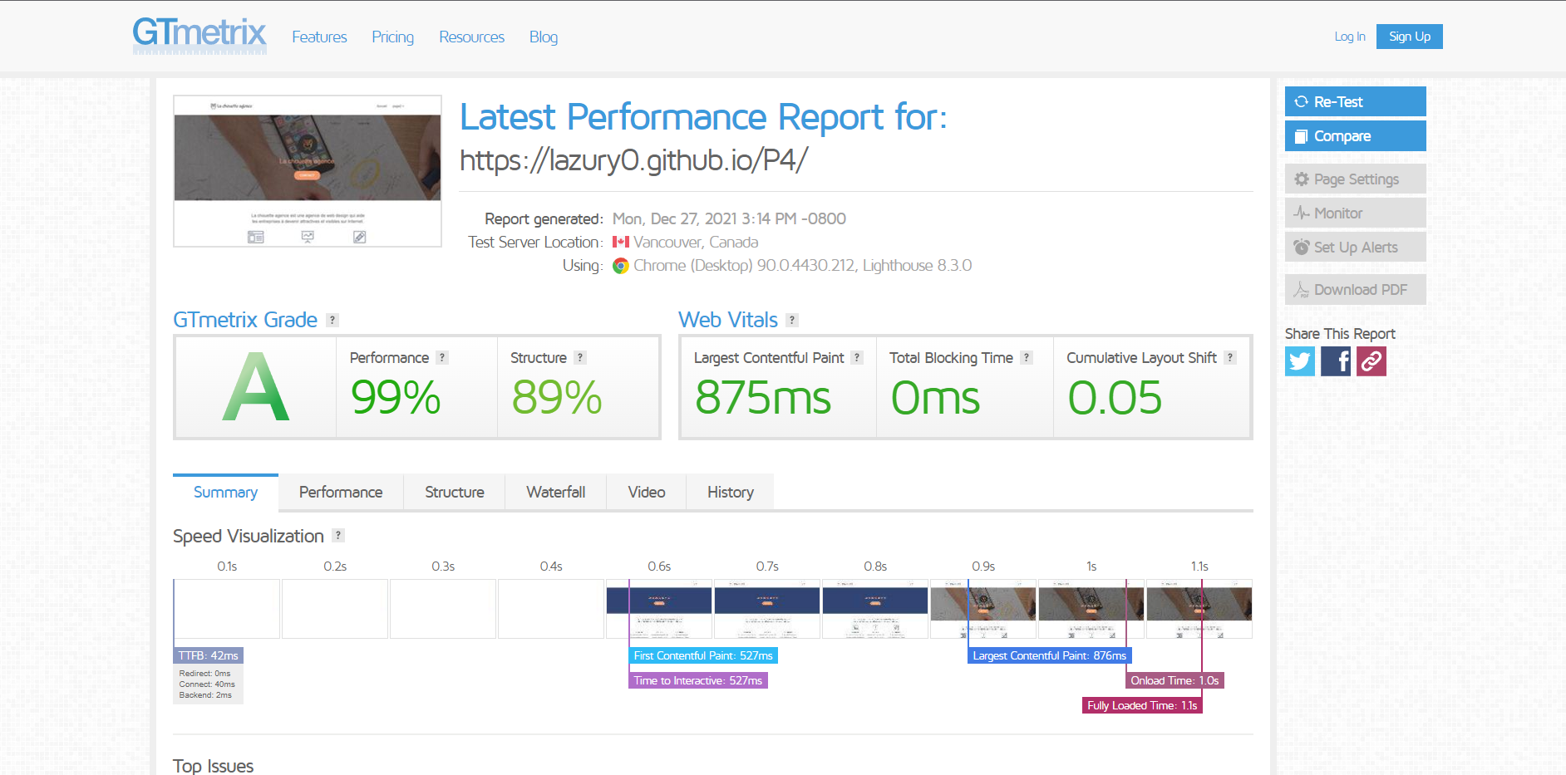
GTmetrix

Slide 5
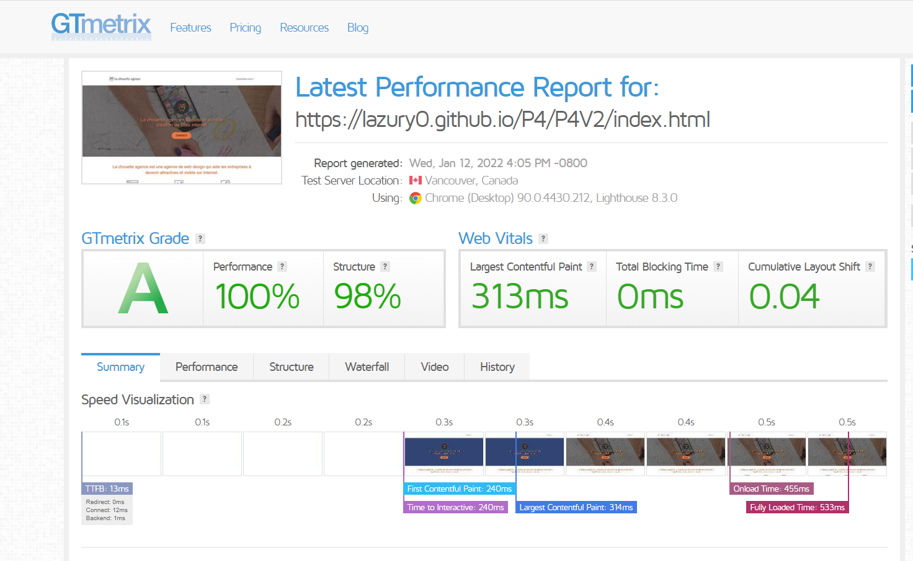
GTmetrix

Slide 6
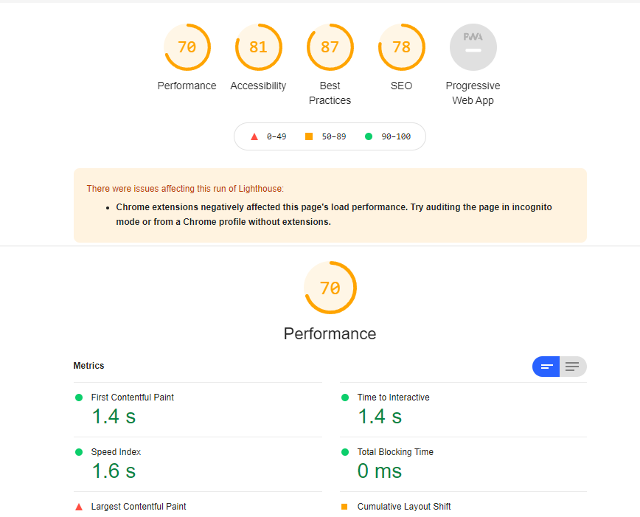
Lighthouse

Slide 7
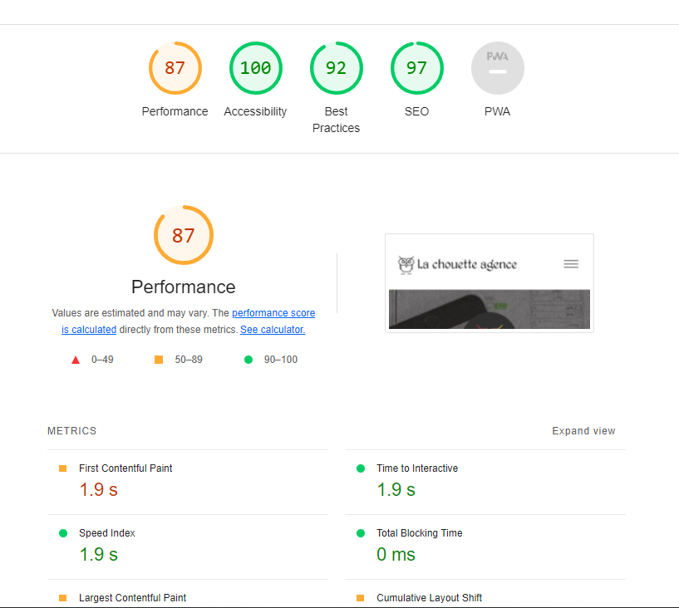
Lighthouse

